Slide 1
Artificial Intelligence Lecture 23: Reinforcement Learning (AIMA Chapter 21)
FALL 2018
Instructor: Prof Sheila Tejada

Slide 2
Pole Demo
Reinforcement Learning
http://www.cs.cornell.edu/selman/demos/pole/pole.html

Slide 3
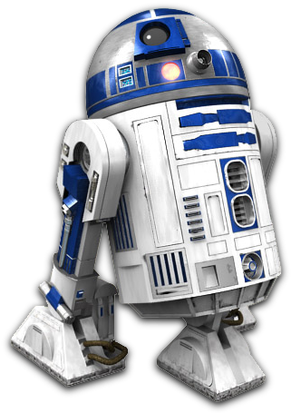
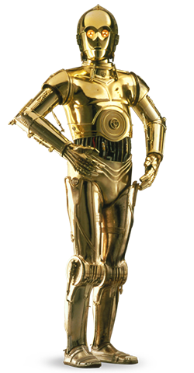

Reinforcement Learning
1 | 2 | 3 | 4
5 |  | 6 | 7
8 | 9 | 10 | 11

Slide 4
Transition Model
Move_{t-1}
Utility
X_{t-1}
X_{t}
X_{t-1} | M_{t-1} | P(X_{t}=1) | P(X_{t}=2) | P(X_{t}=3) | P(X_{t}=4) | P(X_{t}=5) | ...
1 | U | 0.9 | 0.1 | 0.0 | 0.0 | 0.0
1 | D | 0.1 | 0.1 | 0.0 | 0.0 | 0.8
1 | L | 0.9 | 0.0 | 0.0 | 0.0 | 0.1
1 | R | 0.1 | 0.8 | 0.0 | 0.0 | 0.1
2 | U | 0.1 | 0.8 | 0.1 | 0.0 | 0.0
...

Slide 5
Utility Model
X_{t} | Utility
4 | +1
7 | -1
Else | -0.04
Move_{t-1}
Utility
X_{t-1}
X_{t}

Slide 6
Reinforcement Learning
Utility function is unknown at the beginning
When agent visits each state, it receives a reward
Possibly negative
What function should it learn?
R(s): Utility-based agent
If it already knows the transition model
Then use MDP algorithm to solve for MEU actions
U(s,a): Q-learning agent
If it doesn’t already know the transition model
Then pick action that has highest U in current state
𝜋*(s): reflex agent
Learn a policy directly, then pick the action that the policy says

Slide 7
Q Learning
Modify Bellman equation to learn Q values of actions
U(s) = R(s)+𝛾max_{a}∑_{s1}(P(s₁|s,a)U(s₁))
We don’t know R or P
But when we perform a’ in s, we move to s’ and receive R(s)
We want Q(s,a) = Expected utility of performing a in state s
Update Q after each step
If we get a good reward now, then increase Q
If we later get to a state with high Q, then increase Q here too
Q(s,a)← Q(s,a) + ⍺(R(s)+𝛾 max_{a’}Q(s’,a’)−Q(s,a))
⍺ is the learning rate, 𝛾 is the discount factor
Converges to correct values if ⍺ decays over time
Similar to simulated annealing

Slide 8
Q Learning
Modify Bellman equation to learn Q values of actions
U(s) = R(s)+𝛾max_{a}∑_{s1}(P(s₁|s,a)U(s₁))
We don’t know R or P
But when we perform a’ in s, we move to s’ and receive R(s)
We want Q(s,a) = Expected utility of performing a in state s
Update Q after each step
If we get a good reward now, then increase Q
If we later get to a state with high Q, then increase Q here too
Q(s,a)← (1-⍺)Q(s,a) + ⍺(R(s)+𝛾 max_{a’}Q(s’,a’))
⍺ is the learning rate, 𝛾 is the discount factor
Converges to correct values if ⍺ decays over time
Similar to simulated annealing

Slide 9
Reward function of this environment
1 | 2 | 3 | 4
5 |  | 6 | 7
8 | 9 | 10 | 11
−.04
−.04
−.04
+1
−.04
−.04
−1
−.04
−.04
−.04
−.04

Slide 10
Initial Q Values
⍺ = 0.1 𝛾 = 1
U: 0.0
D: 0.0
L: 0.0
R: 0.0
U: 0.0
D: 0.0
L: 0.0
R: 0.0
U: 0.0
D: 0.0
L: 0.0
R: 0.0
U: 0.0
D: 0.0
L: 0.0
R: 0.0
1 | 2 | 3 | 4
5 |  | 6 | 7
8 | 9 | 10 | 11
U: 0.0
D: 0.0
L: 0.0
R: 0.0
U: 0.0
D: 0.0
L: 0.0
R: 0.0
U: 0.0
D: 0.0
L: 0.0
R: 0.0
U: 0.0
D: 0.0
L: 0.0
R: 0.0
U: 0.0
D: 0.0
L: 0.0
R: 0.0
U: 0.0
D: 0.0
L: 0.0
R: 0.0
U: 0.0
D: 0.0
L: 0.0
R: 0.0

Slide 11
Step 1
Q(s,a)← (1−⍺)Q(s,a) + ⍺(R(s)+𝛾 max_{a’}Q(s’,a’))
U: 0.0
D: 0.0
L: 0.0
R: 0.0
U: 0.0
D: 0.0
L: 0.0
R: 0.0
U: 0.0
D: 0.0
L: 0.0
R: 0.0
U: 0.0
D: 0.0
L: 0.0
R: 0.0
1 | 2 | 3 | 4
5 |  | 6 | 7
8 | 9 | 10 | 11
U: 0.0
D: 0.0
L: 0.0
R: 0.0
U: 0.0
D: 0.0
L: 0.0
R: 0.0
U: 0.0
D: 0.0
L: 0.0
R: 0.0
U: 0.0
D: 0.0
L: 0.0
R: 0.0
U: 0.0
D: 0.0
L: 0.0
R: 0.0
U: 0.0
D: 0.0
L: 0.0
R: 0.0
U: 0.0
D: 0.0
L: 0.0
R: 0.0

Slide 12
Step 1
Q(1,R)← (1−⍺)Q(1,R) + ⍺(R(1)+𝛾 max_{a’}Q(2,a’))
U: 0.0
D: 0.0
L: 0.0
R: 0.0
U: 0.0
D: 0.0
L: 0.0
R: 0.0
U: 0.0
D: 0.0
L: 0.0
R: 0.0
U: 0.0
D: 0.0
L: 0.0
R: 0.0
1 | 2 | 3 | 4
5 |  | 6 | 7
8 | 9 | 10 | 11
U: 0.0
D: 0.0
L: 0.0
R: 0.0
U: 0.0
D: 0.0
L: 0.0
R: 0.0
U: 0.0
D: 0.0
L: 0.0
R: 0.0
U: 0.0
D: 0.0
L: 0.0
R: 0.0
U: 0.0
D: 0.0
L: 0.0
R: 0.0
U: 0.0
D: 0.0
L: 0.0
R: 0.0
U: 0.0
D: 0.0
L: 0.0
R: 0.0

Slide 13
Step 1
Q(1,R)← (1−⍺)Q(1,R) + ⍺(−0.04+𝛾 max_{a’}Q(2,a’))
U: 0.0
D: 0.0
L: 0.0
R: 0.0
U: 0.0
D: 0.0
L: 0.0
R: 0.0
U: 0.0
D: 0.0
L: 0.0
R: 0.0
U: 0.0
D: 0.0
L: 0.0
R: 0.0
1 | 2 | 3 | 4
5 |  | 6 | 7
8 | 9 | 10 | 11
U: 0.0
D: 0.0
L: 0.0
R: 0.0
U: 0.0
D: 0.0
L: 0.0
R: 0.0
U: 0.0
D: 0.0
L: 0.0
R: 0.0
U: 0.0
D: 0.0
L: 0.0
R: 0.0
U: 0.0
D: 0.0
L: 0.0
R: 0.0
U: 0.0
D: 0.0
L: 0.0
R: 0.0
U: 0.0
D: 0.0
L: 0.0
R: 0.0

Slide 14
Step 1
Q(1,R)← (1−⍺)Q(1,R) + ⍺(−0.04+𝛾 0.0)
U: 0.0
D: 0.0
L: 0.0
R: 0.0
U: 0.0
D: 0.0
L: 0.0
R: 0.0
U: 0.0
D: 0.0
L: 0.0
R: 0.0
U: 0.0
D: 0.0
L: 0.0
R: 0.0
1 | 2 | 3 | 4
5 |  | 6 | 7
8 | 9 | 10 | 11
U: 0.0
D: 0.0
L: 0.0
R: 0.0
U: 0.0
D: 0.0
L: 0.0
R: 0.0
U: 0.0
D: 0.0
L: 0.0
R: 0.0
U: 0.0
D: 0.0
L: 0.0
R: 0.0
U: 0.0
D: 0.0
L: 0.0
R: 0.0
U: 0.0
D: 0.0
L: 0.0
R: 0.0
U: 0.0
D: 0.0
L: 0.0
R: 0.0

Slide 15
Step 1
Q(1,R)← (1−⍺)0.0 + ⍺(−0.04+𝛾 0.0)
U: 0.0
D: 0.0
L: 0.0
R: 0.0
U: 0.0
D: 0.0
L: 0.0
R: 0.0
U: 0.0
D: 0.0
L: 0.0
R: 0.0
U: 0.0
D: 0.0
L: 0.0
R: 0.0
1 | 2 | 3 | 4
5 |  | 6 | 7
8 | 9 | 10 | 11
U: 0.0
D: 0.0
L: 0.0
R: 0.0
U: 0.0
D: 0.0
L: 0.0
R: 0.0
U: 0.0
D: 0.0
L: 0.0
R: 0.0
U: 0.0
D: 0.0
L: 0.0
R: 0.0
U: 0.0
D: 0.0
L: 0.0
R: 0.0
U: 0.0
D: 0.0
L: 0.0
R: 0.0
U: 0.0
D: 0.0
L: 0.0
R: 0.0

Slide 16
Step 1
Q(1,R)← 0.1(−0.04+0.0)
U: 0.0
D: 0.0
L: 0.0
R: 0.0
U: 0.0
D: 0.0
L: 0.0
R: 0.0
U: 0.0
D: 0.0
L: 0.0
R: 0.0
U: 0.0
D: 0.0
L: 0.0
R: 0.0
1 | 2 | 3 | 4
5 |  | 6 | 7
8 | 9 | 10 | 11
U: 0.0
D: 0.0
L: 0.0
R: 0.0
U: 0.0
D: 0.0
L: 0.0
R: 0.0
U: 0.0
D: 0.0
L: 0.0
R: 0.0
U: 0.0
D: 0.0
L: 0.0
R: 0.0
U: 0.0
D: 0.0
L: 0.0
R: 0.0
U: 0.0
D: 0.0
L: 0.0
R: 0.0
U: 0.0
D: 0.0
L: 0.0
R: 0.0

Slide 17
Step 1
Q(1,R)← −0.004
U: 0.0
D: 0.0
L: 0.0
R: -0.004
U: 0.0
D: 0.0
L: 0.0
R: 0.0
U: 0.0
D: 0.0
L: 0.0
R: 0.0
U: 0.0
D: 0.0
L: 0.0
R: 0.0
1 | 2 | 3 | 4
5 |  | 6 | 7
8 | 9 | 10 | 11
U: 0.0
D: 0.0
L: 0.0
R: 0.0
U: 0.0
D: 0.0
L: 0.0
R: 0.0
U: 0.0
D: 0.0
L: 0.0
R: 0.0
U: 0.0
D: 0.0
L: 0.0
R: 0.0
U: 0.0
D: 0.0
L: 0.0
R: 0.0
U: 0.0
D: 0.0
L: 0.0
R: 0.0
U: 0.0
D: 0.0
L: 0.0
R: 0.0

Slide 18
Step 2
Q(2,R)← (1−⍺)Q(2,R) + ⍺(R(2)+𝛾 max_{a’}Q(3,a’))
U: 0.0
D: 0.0
L: 0.0
R: -0.004
U: 0.0
D: 0.0
L: 0.0
R: -0.004
U: 0.0
D: 0.0
L: 0.0
R: 0.0
U: 0.0
D: 0.0
L: 0.0
R: 0.0
1 | 2 | 3 | 4
5 |  | 6 | 7
8 | 9 | 10 | 11
U: 0.0
D: 0.0
L: 0.0
R: 0.0
U: 0.0
D: 0.0
L: 0.0
R: 0.0
U: 0.0
D: 0.0
L: 0.0
R: 0.0
U: 0.0
D: 0.0
L: 0.0
R: 0.0
U: 0.0
D: 0.0
L: 0.0
R: 0.0
U: 0.0
D: 0.0
L: 0.0
R: 0.0
U: 0.0
D: 0.0
L: 0.0
R: 0.0

Slide 19
Step 3
Q(3,R)← (1−⍺)Q(3,R) + ⍺(R(3)+𝛾 max_{a’}Q(4,a’))
U: 0.0
D: 0.0
L: 0.0
R: -0.004
U: 0.0
D: 0.0
L: 0.0
R: -0.004
U: 0.0
D: 0.0
L: 0.0
R: -0.004
U: 0.0
D: 0.0
L: 0.0
R: 0.0
1 | 2 | 3 | 4
5 |  | 6 | 7
8 | 9 | 10 | 11
U: 0.0
D: 0.0
L: 0.0
R: 0.0
U: 0.0
D: 0.0
L: 0.0
R: 0.0
U: 0.0
D: 0.0
L: 0.0
R: 0.0
U: 0.0
D: 0.0
L: 0.0
R: 0.0
U: 0.0
D: 0.0
L: 0.0
R: 0.0
U: 0.0
D: 0.0
L: 0.0
R: 0.0
U: 0.0
D: 0.0
L: 0.0
R: 0.0

Slide 20
Step 4
Q(4,R)← (1−⍺)Q(4,R) + ⍺(R(4))
U: 0.0
D: 0.0
L: 0.0
R: -0.004
U: 0.0
D: 0.0
L: 0.0
R: -0.004
U: 0.0
D: 0.0
L: 0.0
R: -0.004
1 | 2 | 3 | 4
5 |  | 6 | 7
8 | 9 | 10 | 11
+1
U: 0.0
D: 0.0
L: 0.0
R: 0.0
U: 0.0
D: 0.0
L: 0.0
R: 0.0
U: 0.0
D: 0.0
L: 0.0
R: 0.0
U: 0.0
D: 0.0
L: 0.0
R: 0.0
U: 0.0
D: 0.0
L: 0.0
R: 0.0
U: 0.0
D: 0.0
L: 0.0
R: 0.0
U: 0.0
D: 0.0
L: 0.0
R: 0.0

Slide 21
Step 5
Q(1,R)← (1−⍺)Q(1,R) + ⍺(R(s)+𝛾 max_{a’}Q(2,a’))
U: 0.0
D: 0.0
L: 0.0
R: -0.004
U: 0.0
D: 0.0
L: 0.0
R: -0.004
U: 0.0
D: 0.0
L: 0.0
R: -0.004
1 | 2 | 3 | 4
5 |  | 6 | 7
8 | 9 | 10 | 11
+1
U: 0.0
D: 0.0
L: 0.0
R: 0.0
U: 0.0
D: 0.0
L: 0.0
R: 0.0
U: 0.0
D: 0.0
L: 0.0
R: 0.0
U: 0.0
D: 0.0
L: 0.0
R: 0.0
U: 0.0
D: 0.0
L: 0.0
R: 0.0
U: 0.0
D: 0.0
L: 0.0
R: 0.0
U: 0.0
D: 0.0
L: 0.0
R: 0.0

Slide 22
Step 5
Q(1,R)← (1−⍺)Q(1,R) + ⍺(R(s)+𝛾 0.0)
U: 0.0
D: 0.0
L: 0.0
R: -0.004
U: 0.0
D: 0.0
L: 0.0
R: -0.004
U: 0.0
D: 0.0
L: 0.0
R: -0.004
1 | 2 | 3 | 4
5 |  | 6 | 7
8 | 9 | 10 | 11
+1
U: 0.0
D: 0.0
L: 0.0
R: 0.0
U: 0.0
D: 0.0
L: 0.0
R: 0.0
U: 0.0
D: 0.0
L: 0.0
R: 0.0
U: 0.0
D: 0.0
L: 0.0
R: 0.0
U: 0.0
D: 0.0
L: 0.0
R: 0.0
U: 0.0
D: 0.0
L: 0.0
R: 0.0
U: 0.0
D: 0.0
L: 0.0
R: 0.0

Slide 23
Step 5
Q(1,R)← −0.0076
U: 0.0
D: 0.0
L: 0.0
R: -0.0076
U: 0.0
D: 0.0
L: 0.0
R: -0.004
U: 0.0
D: 0.0
L: 0.0
R: -0.004
1 | 2 | 3 | 4
5 |  | 6 | 7
8 | 9 | 10 | 11
+1
U: 0.0
D: 0.0
L: 0.0
R: 0.0
U: 0.0
D: 0.0
L: 0.0
R: 0.0
U: 0.0
D: 0.0
L: 0.0
R: 0.0
U: 0.0
D: 0.0
L: 0.0
R: 0.0
U: 0.0
D: 0.0
L: 0.0
R: 0.0
U: 0.0
D: 0.0
L: 0.0
R: 0.0
U: 0.0
D: 0.0
L: 0.0
R: 0.0

Slide 24
Q Learning
Converge to correct values
Assuming agent tries all actions, in all states, many times
Otherwise, there won’t be enough experience to learn Q
And if ⍺ decays over time
Similar to simulated annealing
Avoids the complexity of solving an MDP
MDP requires solving for the optimal policy before starting
An RL agent can start right away and then learn as it goes
Although this might be wasteful if you already know P and R

Slide 25
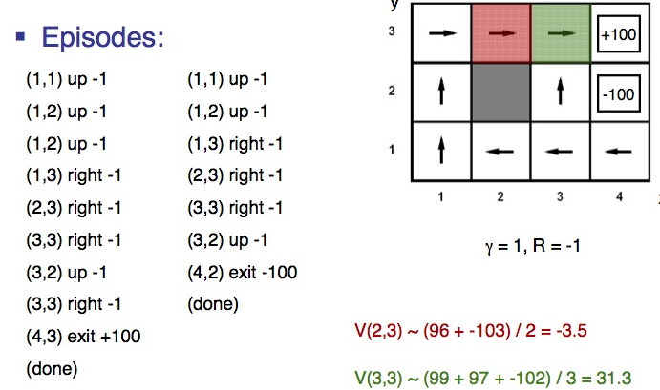
Q-Learning
Q(s,a)← (1-⍺)Q(s,a) + ⍺(R(s)
+ 𝛾 max_{a’}Q(s’,a’))
Example 1
(1,1) up 0
(1,2) up 0
(1,3) right 0
(2,3) right 0
(3,3) right 0
(4,3) exit 100
(done)
Example 2
(1,1) up 0
(1,2) up 0
(1,3) right 0
(2,3) right 0
(3,3) right 0
(4,3) exit 100
(done)
Example 3
(1,1) up 0
(1,2) up 0
(1,3) right 0
(2,3) right 0
(3,3) right 0
(3,2) up 0
(4,2) exit -100
(done)
α=.5 γ = .5 R=0
After E1
Q((2,3),R) = 0 Q((3,3),R) = 0
After E2
Q((2,3),R) = 0 Q((3,3),R) = 25
After E3
Q((2,3),R) =6.25 Q((3,3),R) = 12.5

Slide 26
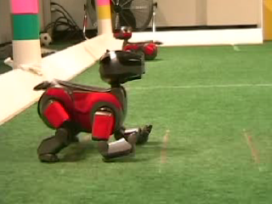
Robot walking demos

Slide 27
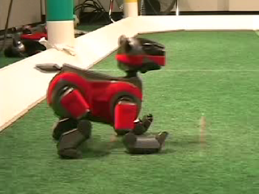
Robot walking demos

